Slide 1

Predicting Sepsis Survival Using Clinical Data
Zhaocheng Yang
Instructor: Andras Zsom
TA: Mingjun Ma
Brown University
Data Science Institute
12/11/2024
GitHub

Slide 2

Introduction
What is Sepsis?
A life-threatening condition triggered by an extreme immune response to infection.
Importance
1. High mortality rate
2. Early prediction is critical for timely intervention and treatment
Objective
Build a classification model to predict patient survival using clinical features.
Data Source:
2. Dataset from Norwegian hospital admissions (2011-2012) of patients with sepsis-related diagnoses.
1. UC Irvine Machine Learning Repository

Slide 3
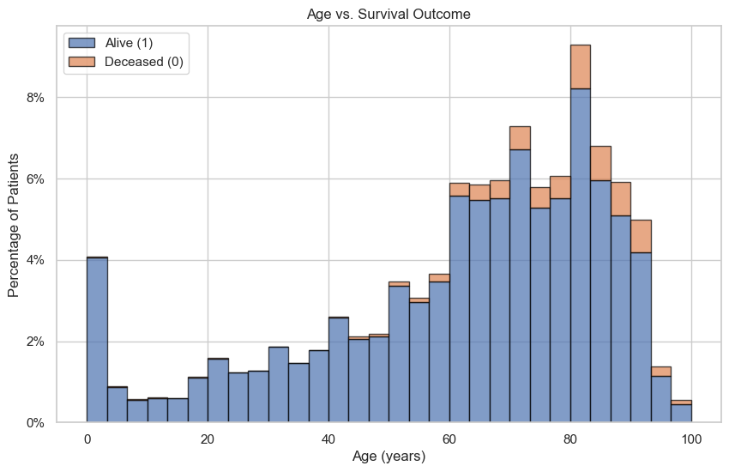
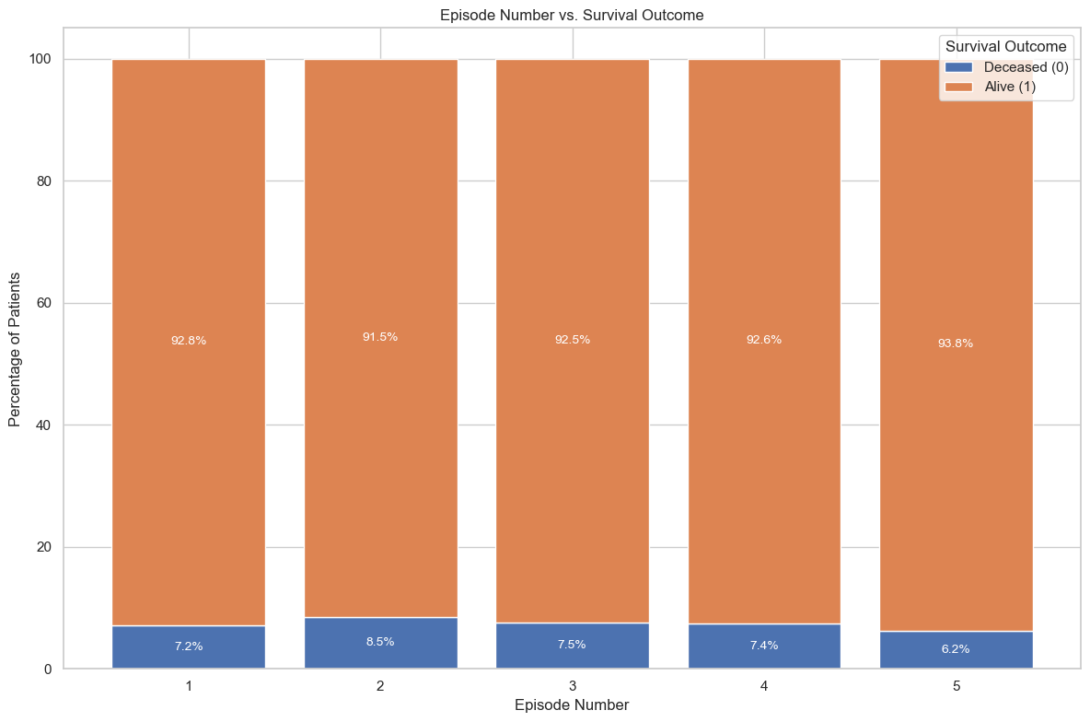
EDA Recap
Number of rows: 110,341
Number of columns: 4
Missing Values: NO
Age: Age of the patient in years.
Sex: Gender of the patient. (0: male, 1: female)
Episode Number: Number of prior Sepsis episodes [1, 2, 3, 4, 5]
Hospital_Outcome: Status of the patient after 9,351 days of being admitted to the hospital. (0: Decreased, 1: Alive)
Younger patients have higher survival rates.
The mortality does not always increase with more episodes.

Slide 4
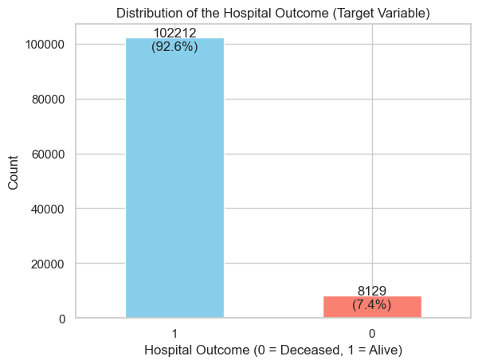
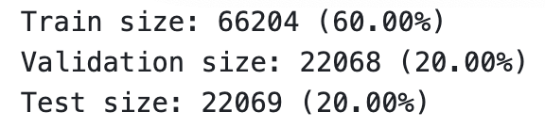
Data Splitting
StratifiedKFold(n_splits=4)
After the Splitting:
 | Train | Validation | Test
1 | 92.6% (61326) | 92.6% (20443) | 92.6% (20443)
0 | 7.4% (4878) | 7.4% (1625) | 7.4% (1626)
The proportion of 0 and 1 remains consistent

Slide 5
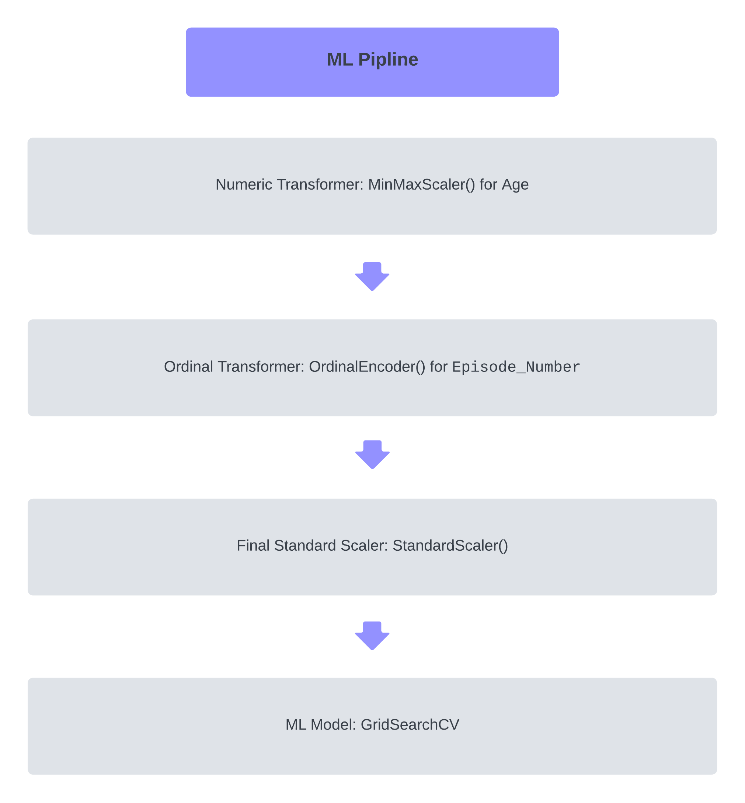
ML Pipeline

Slide 6
Cross-validation
ML Models and their Corresponding Hyperparameters
ML Model | Hyperparameters
Logistic Regression | 'penalty': ['elasticnet’], 'C': [1e-2, 1e-1, 1e0, 1e1], 'l1_ratio': [0, 0.25, 0.5, 0.75, 1]
Random Forest Classifier | max_depth: [2, 3, 4, 5, 6], max_features: [0.7, 0.75, 0.8, 0.85, 0.9]
Kneighbors Classifier | n_neighbors: [1000, 1500, 1700], metric: ['euclidean', 'manhattan'], weights: ['uniform']
XGBoost Classifier | reg_alpha: [1e0, 1e1, 1e2], reg_lambda: [ 1e-2, 1e-1, 1e0, 1e1], max_depth: [1,3,5,7]
Support Vector Classifier | gamma: [1e-1, 1e0, 1e1], C: [1e-1, 1e0, 1e1]

Slide 7
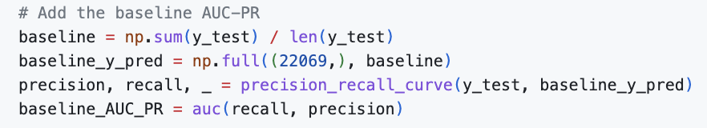
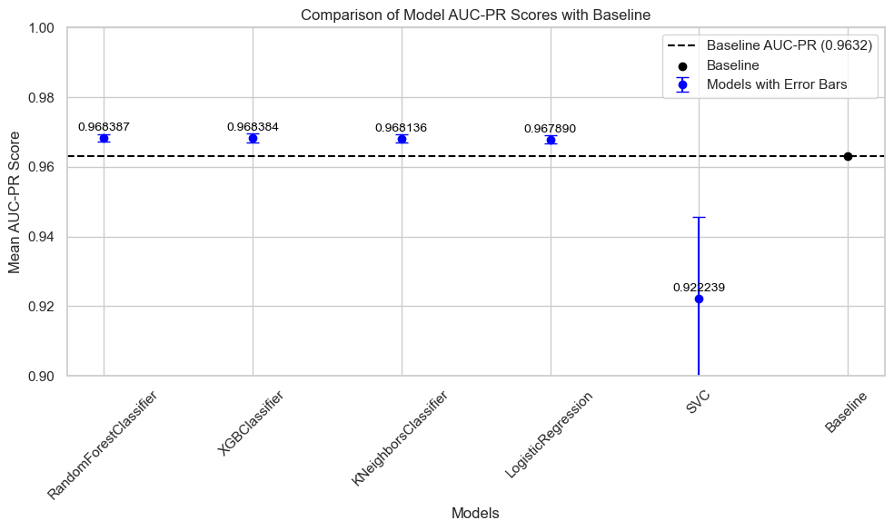
Results
Evaluation metric: AUC-PR Score
Highly imbalanced data
Doesn't consider the true negative rate.
ML Model | Mean Test Score | Standard Deviation
Logistic Regression | 0.9679 | 0.0012
Random Forest Classifier | 0.9684 | 0.0011
Kneighbors Classifier | 0.9681 | 0.0011
XGBoost Classifier | 0.9684 | 0.0013
Support Vector Classifier | 0.9222 | 0.0233

Slide 8
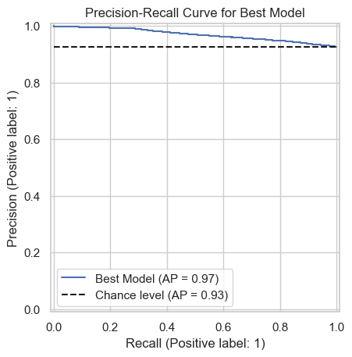
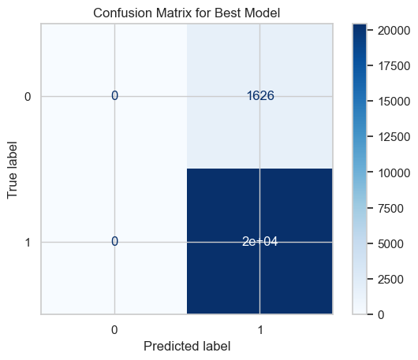
Results
Best Model:
RandomForestClassifier(max_depth=3, max_features=0.8)
(Random State: 42)

Slide 9
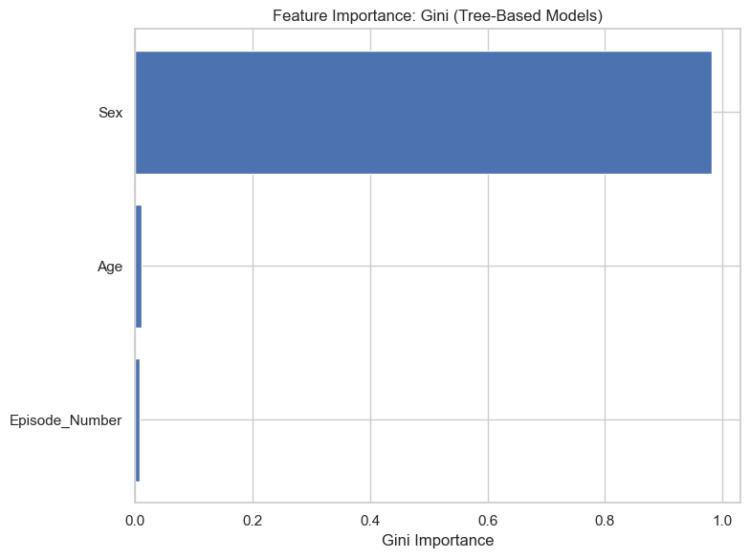
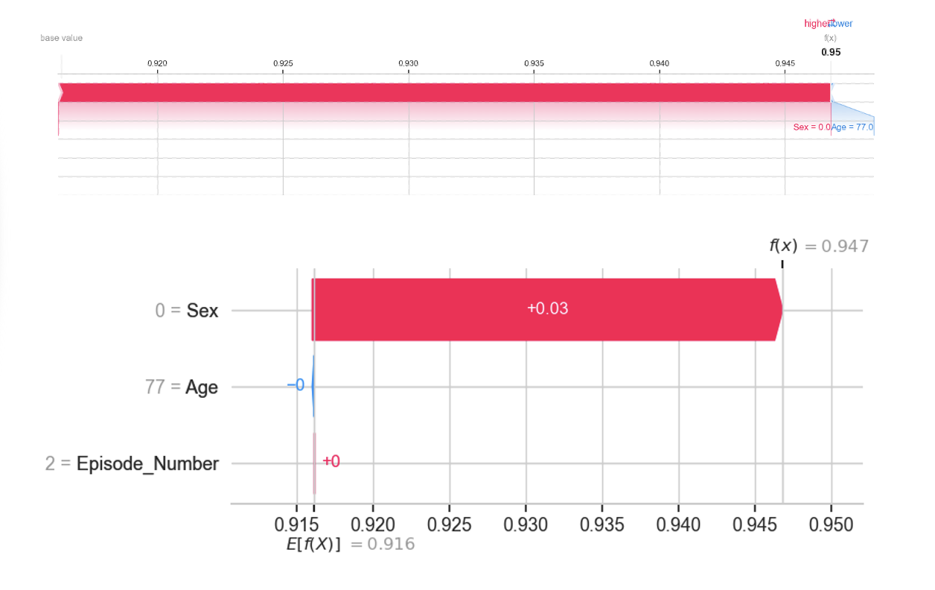
Feature Importance
Sex feature has the strongest influence on the prediction
Age and Episode_Number have almost no contributions
Global:
Local (index=10000):

Slide 10
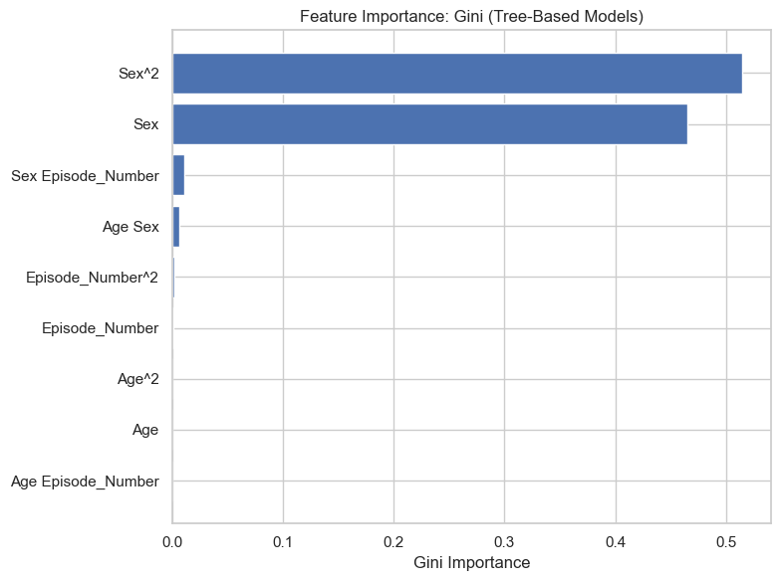
Outlook
Add Class Weights to the Model: Modifies the contribution of each sample to the loss function. modifies the contribution of each sample to the loss function.For example, in RandomForestClassifier, set class_weight='balanced'
Resample the Dataset: Try to use oversampling (e.g., SMOTE) to increase the representation of the minority class or undersampling to reduce the dominance of the positive class.
Try advanced ML classification algorithms like Neural Networks or Naïve Bayes Classifiers.
Try to incorporate it with other datasets to increase more features relevant to the hospital outcome
PolynomialFeatures(2)

Slide 11
Thanks for Watching

Slide 12
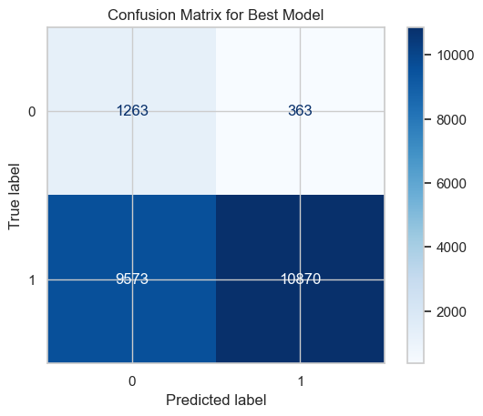
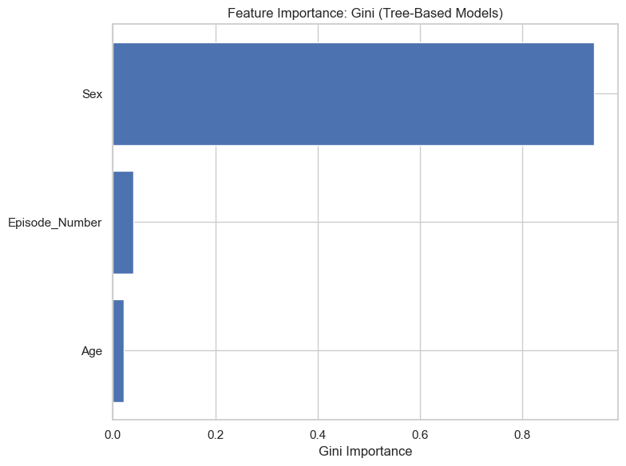
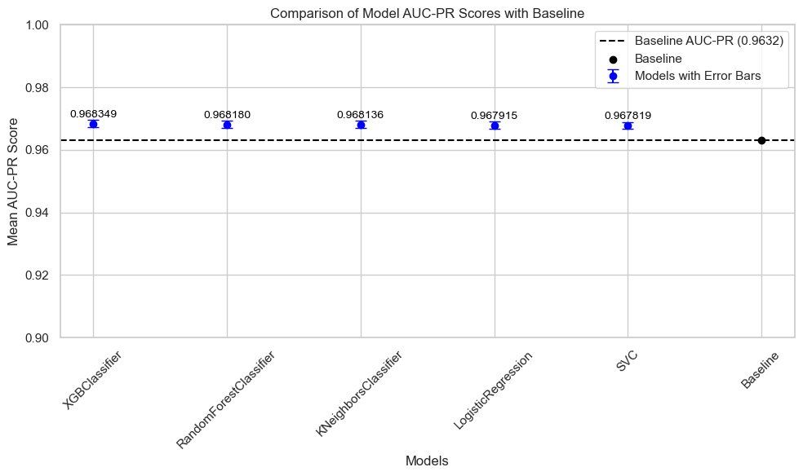
Q&A

